Slide 1
Data Visualization of Diwali Dataset
- Using Matplotlib and Seaborn Library

Slide 2
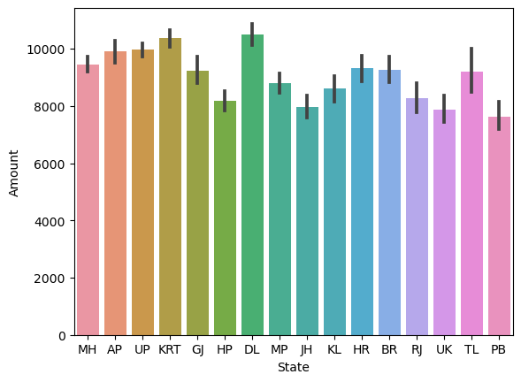
Maximum Amount States are Delhi and Karnataka.

Slide 3
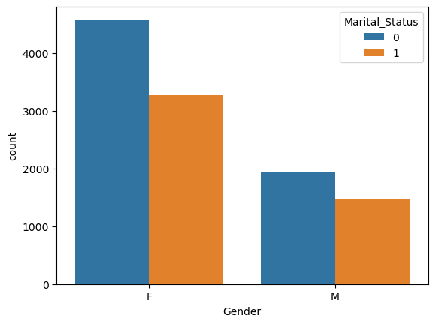
Female Customers are more than Male.

Slide 4
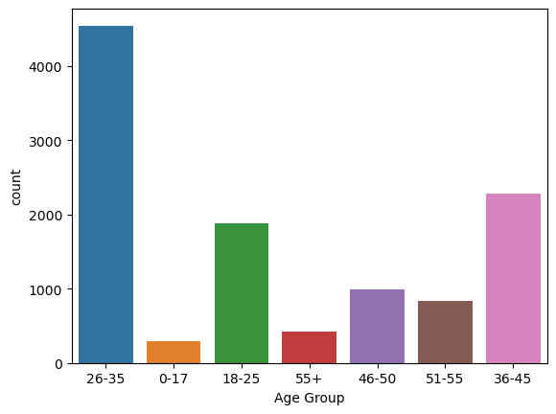
Maximum Customers are Age Group of 26-35.

Slide 5
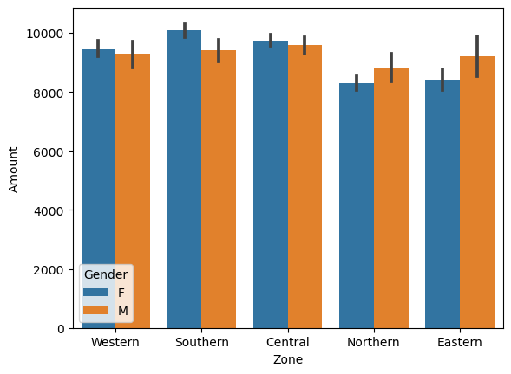
Southern Zone’s Females Spend more Amount.

Slide 6
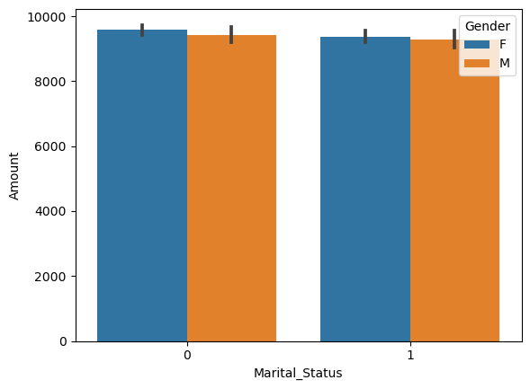
Unmarried Females Spend Mare Amount.

Slide 7
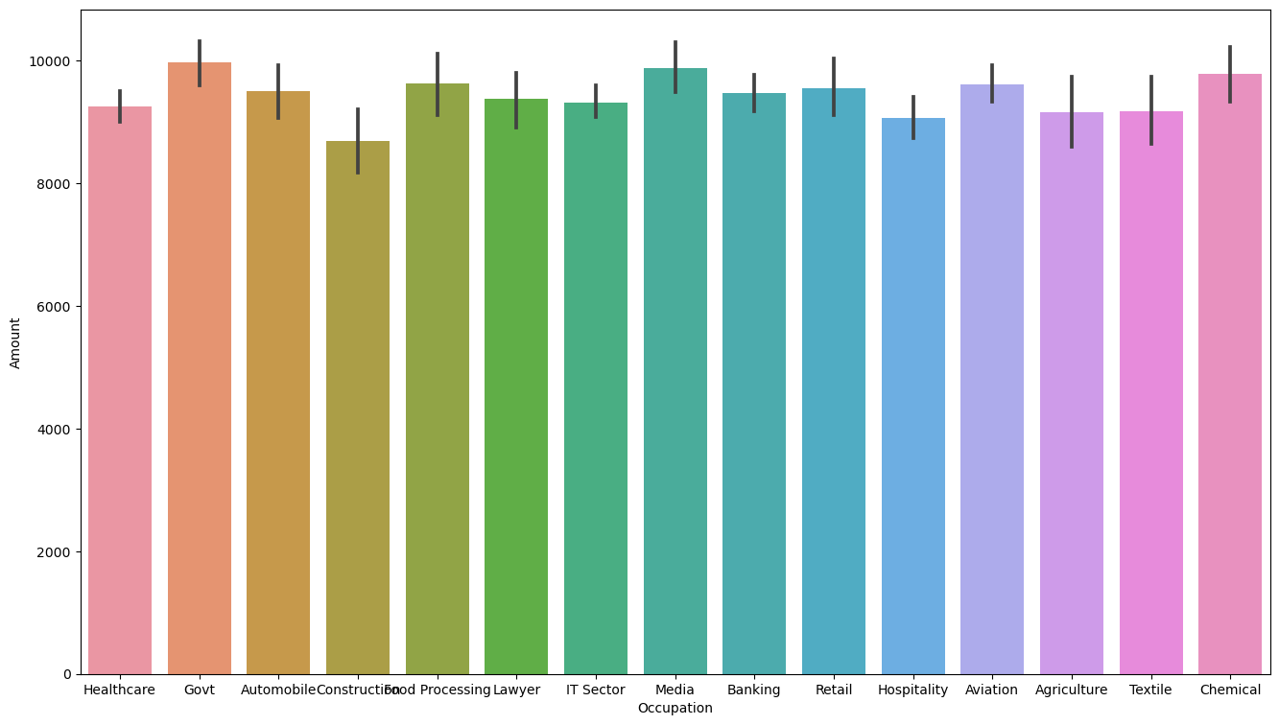
Amount Spend according to Occupation.

Slide 8
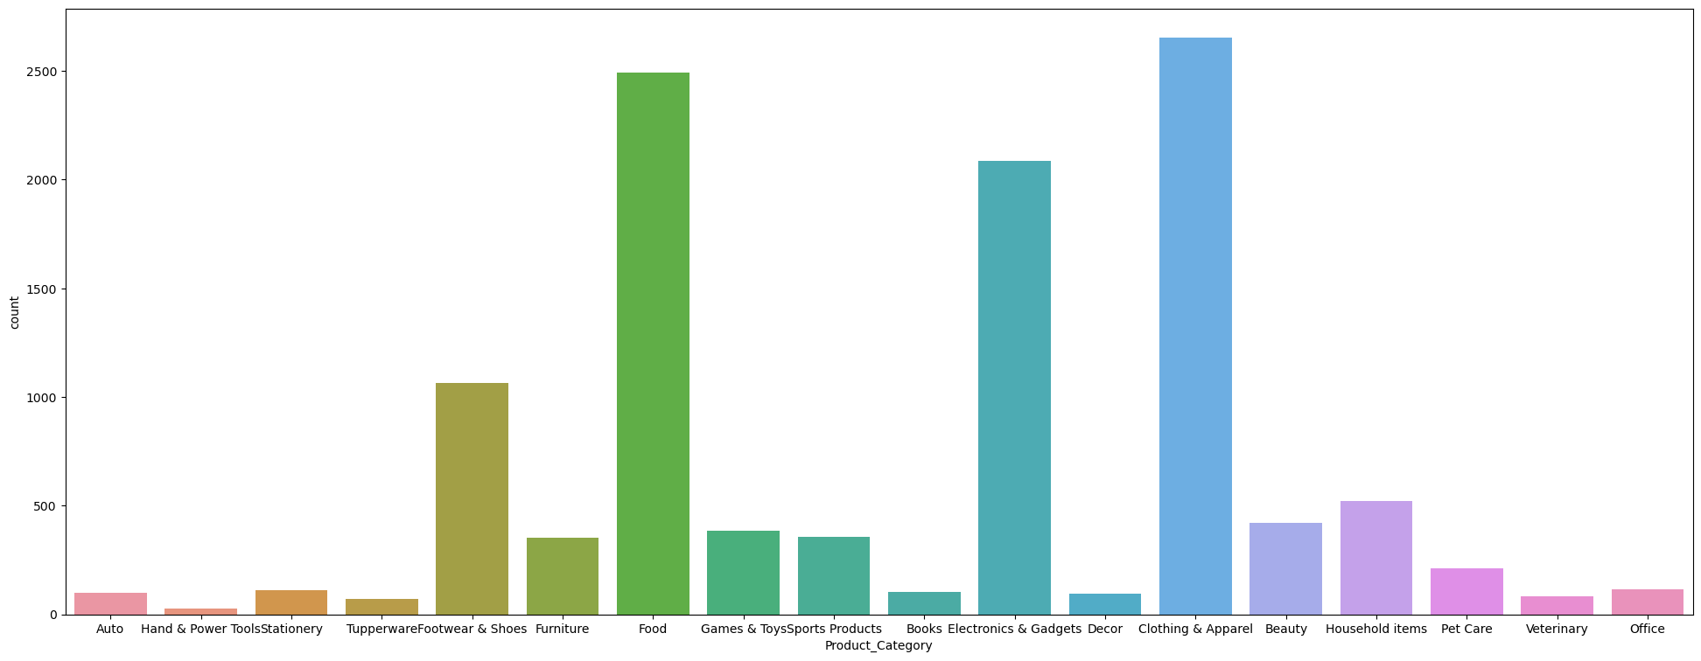
Maximum Sales in Clothing Category.

Slide 9
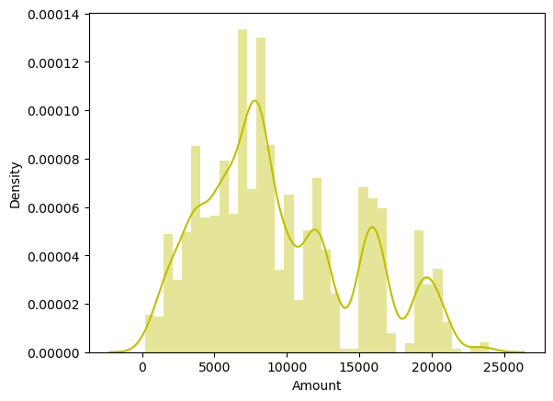
Most of the Customers Spend Amount between 7000-9000.

Slide 10
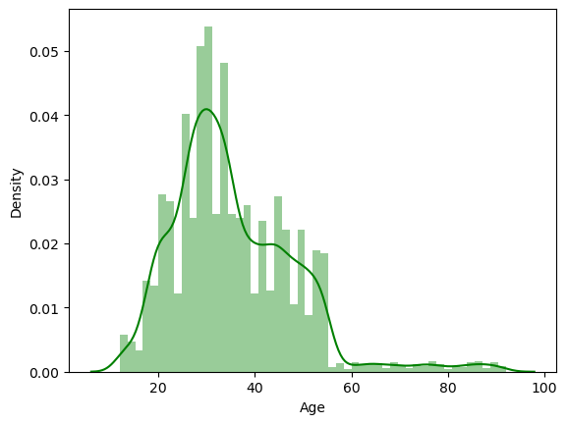
Most of the Customer’s age between 25-35.

Slide 11
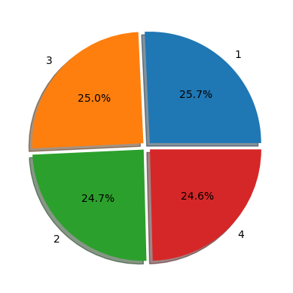
Orders of Customers.

Slide 12
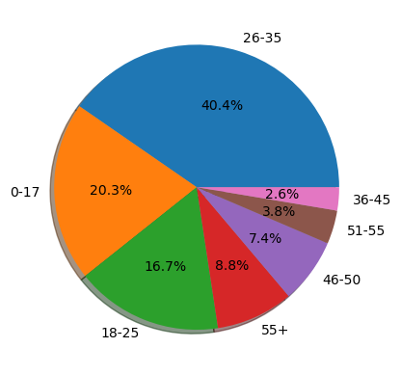
Age Group of Customers.

